Slide 1
Data Access Patterns
Some of the problems with data access from OO programs:
  Data source and OO program use different data modelling concepts
  Decoupling domain logic from database technology

Slide 2
Problems in Data Access (2)
Access to data varies depending on the source of the data.
  type of storage (relational databases, object-oriented databases, flat files, etc)
  particular vendor implementation for a type.
When business components need to access a data source, they can use the appropriate API to achieve connectivity and manipulate the data source.
Problem: coupling between the components and the data source implementation: appears when including the connectivity and data access code provided by different API’s within the business components (domain objects)
  Such code dependencies in components make it difficult to migrate the application from one type of data source to another
Components need to be transparent to the actual persistent store or data source implementation to provide easy migration to different vendor products, different storage types, and different data source types.

Slide 3
Bibliography
  Sun: Core J2EE Pattern Catalog
    http://www.oracle.com/technetwork/java/dataaccessobject-138824.html
  For further reading, only if interested:
    Clifton Nock, Data Access Patterns: Database Interactions in Object Oriented Applications, Addison Wesley, 2003
    Martin Fowler, Patterns of Enterprise Application Architecture http://martinfowler.com/eaaCatalog/index.html

Slide 4
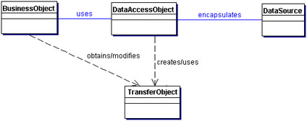
The Data Access Object Pattern
Intent: Abstract and Encapsulate all access to the data source
Sun Developer Network - Core J2EE Patterns
http://www.oracle.com/technetwork/java/dataaccessobject-138824.html

Slide 5
DAO – Participants and responsibilities
BusinessObject: represents the data client. It is the object that requires access to the data source to obtain and store data.
DataAccessObject: the primary object of this pattern. It abstracts the underlying data access implementation for the BusinessObject to enable transparent access to the data source. The BusinessObject also delegates data load and store operations to the DataAccessObject.
DataSource: represents a data source implementation. A data source could be a database such as an RDBMS, OODBMS, XML repository, flat file system, etc.
Transfer Object: used as a data carrier. The DataAccessObject may use a Transfer Object to return data to the client. The DataAccessObject may also receive the data from the client in a Transfer Object to update the data in the data source.

Slide 6
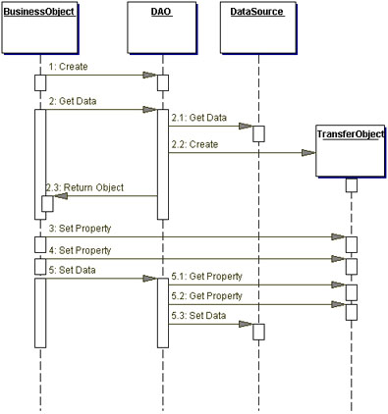

Slide 7
Where to get DAO’s from ?
Strategies to get DAO’s:
  Automatic DAO Code Generation Strategy
  Factory for Data Access Objects Strategy

Slide 8
Automatic DAO Code Generation Strategy
Since each BusinessObject corresponds to a specific DAO, it is possible to establish relationships between the BusinessObject, DAO, and underlying implementations (such as the tables in an RDBMS).
Once the relationships are established, it is possible to write a simple application-specific code-generation utility that generates the code for all DAOs required by the application.
The metadata to generate the DAO:
  can come from a developer-defined descriptor file.
  or, alternatively, the code generator can automatically introspect the database and provide the necessary DAOs to access the database.
If the requirements for DAOs are sufficiently complex, consider using third-party tools that provide object-to-relational mapping for RDBMS databases.
  Examples: Java Persistence API (JPA): Hibernate

Slide 9
Factory for Data Access Objects Strategy
The DAO pattern can be made highly flexible by adopting the Abstract Factory [GoF] and the Factory Method [GoF] patterns
Use Factory Method: When the underlying storage is not subject to change from one implementation to another, use the Factory Method pattern to produce a number of DAOs needed by the application.
Use Abstract Factory: When the underlying storage is subject to change from one implementation to another, this strategy may be implemented using the Abstract Factory pattern. In this case, this strategy provides an abstract DAO factory object (Abstract Factory) that can construct various types of concrete DAO factories, each factory supporting a different type of persistent storage implementation. Once you obtain the concrete DAO factory for a specific implementation, you use it to produce DAOs supported and implemented in that implementation.

Slide 10
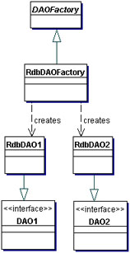
DAO with Factory Method

Slide 11
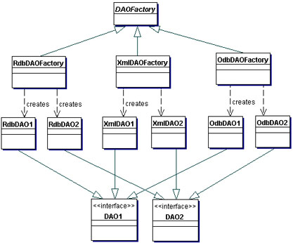
DAO with Abstract Factory

Slide 12
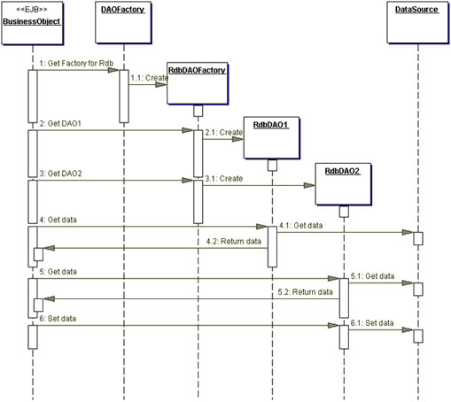

Slide 13
Consequences
Enables Transparency
Enables Easier Migration
.
Reduces Code Complexity in Business Objects:
Adds Extra Layer
Needs Class Hierarchy Design

Slide 14
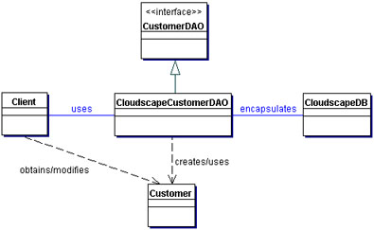
Example

Slide 15
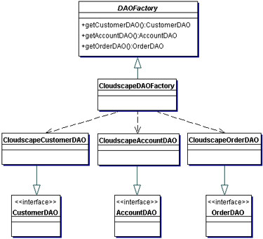
Example- Using Factory Method

Slide 16
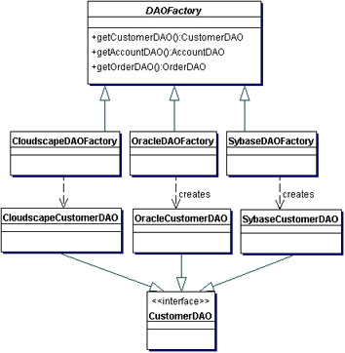
Example- Using Abstract Factory

Slide 17
Abstract class DAO Factory
// Abstract class DAO Factory
public abstract class DAOFactory {
// List of DAO types supported by the factory
public static final int CLOUDSCAPE = 1;
public static final int ORACLE = 2;
public static final int SYBASE = 3;
...
// There will be a method for each DAO that can be created.
//The concrete factories will have to implement these methods.
public abstract CustomerDAO getCustomerDAO();
public abstract AccountDAO getAccountDAO();
public abstract OrderDAO getOrderDAO();
...
public static DAOFactory getDAOFactory( int whichFactory) {
switch (whichFactory) {
case CLOUDSCAPE:
return new CloudscapeDAOFactory();
case ORACLE :
return new OracleDAOFactory();
...
default :
return null;
}
}
}

Slide 18
Cloudscape concrete DAO Factory implementation
import java.sql.*;
public class CloudscapeDAOFactory extends DAOFactory {
public static final String DRIVER=
"COM.cloudscape.core.RmiJdbcDriver";
public static final String DBURL=
"jdbc:cloudscape:rmi://localhost:1099/CoreJ2EEDB";
// method to create Cloudscape connections
public static Connection createConnection() {
// Use DRIVER and DBURL to create a connection
// Recommend connection pool implementation/usage
}
public CustomerDAO getCustomerDAO() {
// CloudscapeCustomerDAO implements CustomerDAO
return new CloudscapeCustomerDAO();
}
public AccountDAO getAccountDAO() {
// CloudscapeAccountDAO implements AccountDAO
return new CloudscapeAccountDAO();
}
public OrderDAO getOrderDAO() {
// CloudscapeOrderDAO implements OrderDAO
return new CloudscapeOrderDAO();
}
...
}

Slide 19
Interface that all CustomerDAOs must support
// Interface that all CustomerDAOs must support
public interface CustomerDAO {
public int insertCustomer(...);
public boolean deleteCustomer(...);
public Customer findCustomer(...);
public boolean updateCustomer(...);
public RowSet selectCustomersRS(...);
public Collection selectCustomersTO(...);
...
}

Slide 20
CloudscapeCustomerDAO implementation
// CloudscapeCustomerDAO implementation of the CustomerDAO interface.
// This class can contain all Cloudscape specific code and SQL statements.
import java.sql.*;
public class CloudscapeCustomerDAO implements CustomerDAO {
public CloudscapeCustomerDAO() {
// initialization
}
// The following methods can use CloudscapeDAOFactory.createConnection()
// to get a connection as required
public int insertCustomer(...) {
// Implement insert customer here.
// Return newly created customer number or a -1 on error
}
public boolean deleteCustomer(...) {
// Implement delete customer here
// Return true on success, false on failure
}
public Customer findCustomer(...) {
// Implement find a customer here using supplied argument values as search criteria
// Return a Transfer Object if found, return null on error or if not found
}

Slide 21
Customer Transfer Object
public class Customer implements java.io.Serializable {
// member variables
int CustomerNumber;
String name;
String streetAddress;
String city;
...
// getter and setter methods...
...
}

Slide 22
Client Code
// Create a DAO
CustomerDAO custDAO = cloudscapeFactory.getCustomerDAO();
// create a new customer
int newCustNo = custDAO.insertCustomer(...);
// Find a customer object. Get the Transfer Object.
Customer cust = custDAO.findCustomer(...);
// modify the values in the Transfer Object.
cust.setAddress(...);
cust.setEmail(...);
// update the customer object using the DAO
custDAO.updateCustomer(cust);
// delete a customer object
custDAO.deleteCustomer(...);
// select all customers in the same city
Customer criteria=new Customer();
criteria.setCity("New York");
Collection customersList = custDAO.selectCustomersTO(criteria);
// returns customersList - collection of Customer
// Transfer Objects. iterate through this collection to
// get values.
...

Slide 23
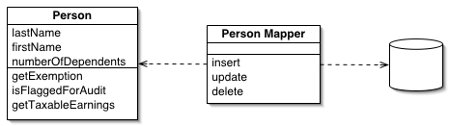
Related Pattern:
Data Mapper [Martin Fowler]
The Data Mapper is a layer of software that separates the in-memory objects from the database. Its responsibility is to transfer data between the two and also to isolate them from each other.
http://martinfowler.com/eaaCatalog/dataMapper.html

Slide 24
DAO and other patterns
DAO is a general and complex pattern
Martin Fowler, Patterns of Enterprise Application Architecture http://martinfowler.com/eaaCatalog/index.html
  Table Data Gateway
  Row Data Gateway
  Active Record/Active DomainObject

Slide 25
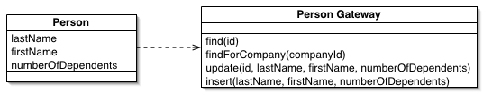
Related Pattern:
Table Data Gateway [Martin Fowler]
A Table Data Gateway holds all the SQL for accessing a single table or view: selects, inserts, updates, and deletes. Other code calls its methods for all interaction with the database. A Table Data Gateway has one instance per table.

Slide 26
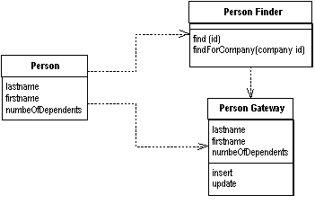
Simpler Pattern:
Row Data Gateway
Row Data Gateway gives you objects that look exactly like the record in your record structure but can be accessed with the regular mechanisms of your programming language. All details of data source access are hidden behind this interface. A Row Data Gateway has one instance per row returned by a query.

Slide 27
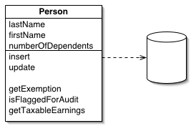
Simplest Pattern:
Active Record/Active DomainObject
An object that wraps a row in a database table, encapsulates the database access, and adds domain logic on that data.
Characteristics:
DomainObjects are dependent on the persistence mechanism
Use only if the DomainModel is simple enough and persistence mechanism does not change

